Slide 1
Coast Guard Maritime Communications

Slide 2
Short Range Communications - Rescue 21

Slide 3
Long Range Communications – MF/HF/Sat
NAVTEX:
NAVTEX is broadcast from Coast Guard facilities in Cape Cod, Chesapeake VA, Charleston, SC, Miami FL, New Orleans LA, San Juan PR, Cambria CA, Pt. Reyes CA, Astoria OR, Kodiak AK, Honolulu HI, and Guam. Although NAVTEX broadcasts from Guam have not been operational since July 2018, Guam continues to broadcast NAVTEX on its backup frequency 4209.5 kHz.

Slide 4
HF DIGITAL SELECTIVE CALLING
HF DIGITAL SELECTIVE CALLING
Portsmouth/NMN, Boston/NMF, Miami/NMA, New Orleans/NMG, Pt. Reyes/NMC, Honolulu HI/NMO, Kodiak AK/NOJ
4207.5 | DSC test calls on 4207.5 kHz will be automatically acknowledged from any of the US Coast Guard Communication Stations listed below EXCEPT USCG SECTOR Guam.
6312
8414.5
12577
16804.5

Slide 5
HF RADIOTELEPHONE (SINGLE SIDEBAND) – DISTRESS AND INITIAL CONTACT
KHz SHIP STATION | KHz COAST STATION | Station and Schedule (UTC)
 |  | NRV (Guam) | NOJ (Kodiak AK)
4125 | 4125 | - | 24 HRS
6215 | 6215 | 0900-2100Z | 24 HRS
8291 | 8291 | - | 24 HRS
12290 | 12290 | 2100-0900Z | -

Slide 6
DISCONTINUED SERVICES
HF RADIOTELEX (SITOR OR NARROW BAND DIRECT PRINTING)
Effective 31 March 2012, the Coast Guard discontinued ALL ship/Shore/Ship SITOR services except for marine information broadcasts.
HF SINGLE SIDEBAND VOICE
Effective 7 February 2022, the U.S. Coast Guard ceased monitoring all High Frequency (HF) shortwave voice distress frequencies within the contiguous United States and Hawaii except for marine information broadcasts.

Slide 7
Emergency Position Indicating Radio Beacon
Electronic Position Indicating Radio-Beacon (EPIRB)
US certified EPIRBs:
Operate a minimum of 48 hours
Include a 121.5 MHz homing signal
May an Automatic Identification System (AIS) locating signal
automatically activate when removed from the bracket and immersed in water
Category 1 is mounted in Hydrostatic release bracket
Category 2 is mounted in manual release bracket
Technical Standards are in 47 CFR Part 80 and RTCM Standard 11000.5
EPIRB requirements are found in 47 CFR Part 80 (EPIRB), 46 CFR Part 25 (Fishing Vessels), 46 CFR Part 117 (Small Passenger Vessels), 46 CFR Part 133 (Offshore Support Vessels), 46 CFR Part 141 (Towing Vessels), 46 CFR Part 180 (Small Passenger Vessels Under 100 GT), and 46 CFR Part 199 (Inspected Vessels)

Slide 8
Personal Locating Beacon
Personal Locating Beacon (PLB)
US certified PLBs are:
Operate a minimum of 24 hours
Manually activated
Include a 121.5 MHz homing signal
May include an Automatic Identification System (AIS) locating signals
May include automatic water activation
No carriage requirements currently exists.
U.S. Coast Guard encourages use of a PLB-AIS when operating more than 3 miles from the shore.
PLB requirements are in 47 CFR Part 95 and the RTCM Standard 11010.4

Slide 9
PLB (Cont)
Provides an alerting signal
Distress alert on recognized distress frequencies, or
An emergency notification via a recognized service
Provides a locating signal:
Signal for radio-direction finding, or
An encoded GNSS position (LAT & LONG) in the message
Devices may combine different technologies to achieve the function:
For example, DSC with AIS or 406 MHz with 121.5 MHz & AIS

Slide 10
PLB (Cont)
Interest in the use of the devices has increased significantly following the EL FARO, SCANDIES ROSE and more recently the SEACOR POWER. In the after-action review of the event the National Transportation Safety Board recommended the use of these devices.
Of note in one of these cases the crew grabbed a Radar SART (Search and Rescue Transponder) to facilitate their rescue, but the device didn’t activate, or local responders did not take de-tune their radars to locate the SARTS.

Slide 11
Coast Guard outreach
NAVCEN.uscg.gov website
Safety Alert
https://www.dco.uscg.mil/Our-Organization/Assistant-Commandant-for-Prevention-Policy-CG-5P/Inspections-Compliance-CG-5PC-/Office-of-Investigations-Casualty-Analysis/Safety-Alerts/
Maritime Safety Information Bulletins https://www.dco.uscg.mil/Featured-Content/Mariners/Marine-Safety-Information-Bulletins-MSIB/
Maritime Commons Blog https://www.news.uscg.mil/maritime-commons/

Slide 12
Recent Safety related notices
MSIB 9/23 Maritime Mobile Service Identities (MMSIs): What to do when Selling or Disposing of your Radio or Radio-equipped Vessel
MSIB 3/22 Newly published technical standard addresses LED radio interference to maritime VHF radio and AIS
MSIB 10/21 High Frequency Voice Distress Watchkeeping will cease at most locations on 7 February 2022
Safety Alert 01/24 You may not receive AIS broadcast whenever a VHF maritime radio is keyed
General safety notice – ensure that your VHF DSC radio is attached to your GPS to provide LAT/LONG information in the event of an emergency

Slide 13
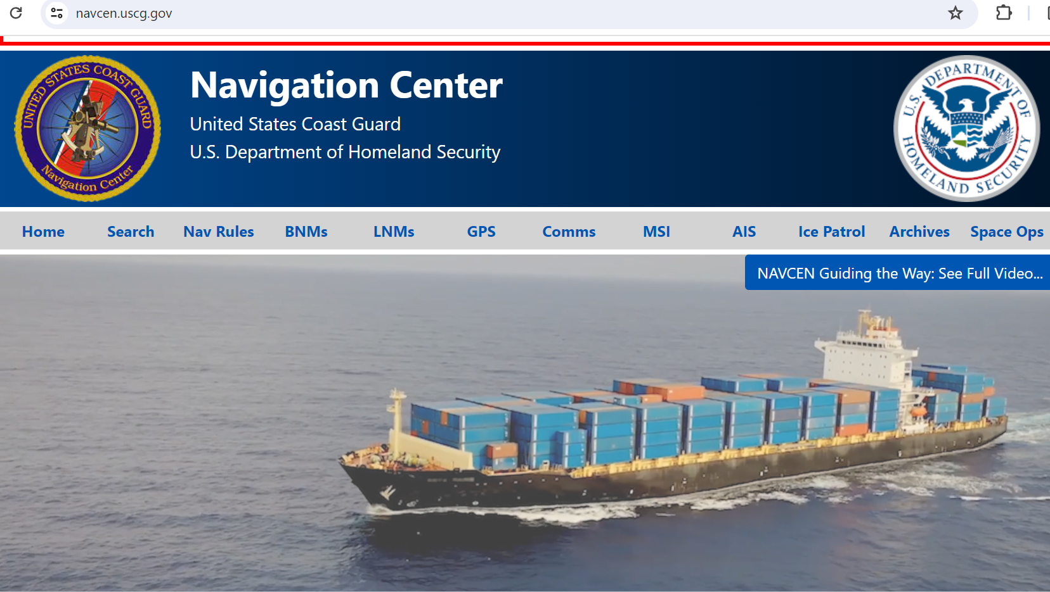

Slide 14
Communications Questions
The Navigation Center Website offers a direct method for asking the Coast Guard questions on Communications and Navigation related topics that are covered on the site.
Using the https://www.navcen.uscg.gov/contact/contact-us address will allow questions to be answered by a Coast Guard subject matter expert on the topic.
The Office of Spectrum Management & Communication Policy Division (CG-672) attempts to answer the questions the next business day – some question may require more time to research the answer.

Slide 15
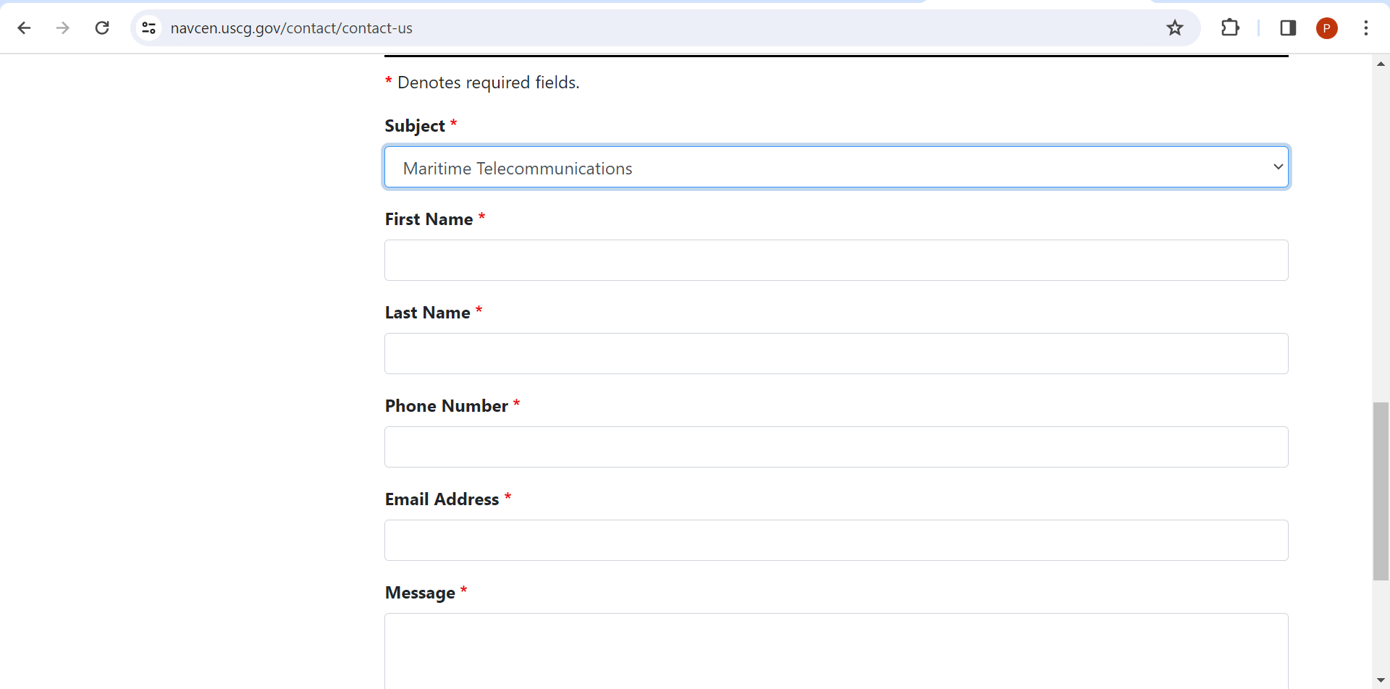
Example of other subjects:
Aids to Navigation
AIS
GPS
LNM’s, Charts, Corrections
LRIT
Maritime Safety Info
Navigation
Navigation Rules
VTS
and other options

Slide 16
More questions?
For a more direct approach you can contact my office directly at: HQS-SMB-CG-672@uscg.mil
Sending us your questions gives us time to interact with other Coast Guard offices like Search & Rescue, Commercial Vessel Compliance, Navigation as well as other agencies like the Federal Communications Commission and National Oceanic and Atmospheric Administration/ National Weather Service

Slide 17
Starlink
Starlink’s maritime system is currently a data system similar to an internet service provider (ISP), adequate for general use, and appears to be maritime worthy but is not certified as adequate for emergency situations. Further evaluation of the shipboard terminal equipment would be required to determine suitability for maritime use.
Does the USCG have any “established means” of routing distress calls / or distress messages coded or uncoded to the USCG other than telephone?
Starlink has not approached the USCG to establish a standard means of providing emergency alerts in accordance with the guidance provided in 47 CFR Part 25 Subpart E for Satellite Emergency Notification Devices (SENDs) and the RTCM Standard 12800.0 (incorporated by reference, see § 25.108). Failure to adhere to this section implies any satellite device using Starlink is not intended for nor suited to be used for emergency notification.

Slide 18
Starlink (cont)
Our review of the 46 CFR § 28.245 and 47 CFR § 80 regulations, identifies the required communications capability as voice communications or a recognized GMDSS service. The regulations state radiotelephone which infers voice communications and that a cellular telephone capable of communicating with a public coast station or a U.S. Coast Guard station or satellite communications capability with the system servicing the area in which the vessel is operating may be an acceptable alternative. As Starlink is a data communications service (e.g., ISP), it would not meet the requirement for voice communications with a public coast station or a U.S. Coast Guard station.

Slide 19
Starlink (cont)
If Starlink wishes to be accepted under the GMDSS, the company would have to apply to the IMO for recognition in accordance with IMO Resolution A.1001(98).
As multiple types of Starlink user equipment may be available on the market, the specific terminal equipment proposed for maritime use must be evaluated to determine if the functionality and capabilities meet the regulations. As both the FCC and USCG are equally involved, a specific process may need to be defined. Specific terminal models evaluated as meeting the regulations may be granted a waiver.
CG-672 and CG-SAR recommended Coast Guard position is that Starlink as commercially defined and described is not compatible with the regulations in 46 CFR and 47 CFR and that the USCG not endorse any general request for waivers.

Slide 20
Future Efforts
A RDC project in FY24 will assess the receipt and routing of digital emergency notification messages, such as the SENDs, iPhone 14 SOS, and other sources, to Rescue Coordination Centers (RCC).

